Slide 1
Non-Contact Vital Sign Monitoring System: Proposal Presentation
Zachary Lasater (Group Leader)
Andrew Renuart (Webmaster)
Ahmed Elsabbagh
Anthony Genutis
Julian Rosker

Slide 2
Motivation
Sleep Apnea
Accessibility
Burn Victims
Environmental Factors
Interference
Heart & respiration rates:
More Accurate
Cheaper
Non-obtrusive
More Readily Available
Viable

Slide 3
Objective
Use the existing antennas and function generator to build a system that will report heart and respiration rates of a user in real time without physical contact with aforementioned user.

Slide 4
Goals
Heart & respiration rates:
Easy to interpret
Easy to setup
Real Time
Cheap
Convenient

Slide 5
Components
Signal Generator
Antennas
ADC
MCU
PC software & GUI
Communication Protocols

Slide 6
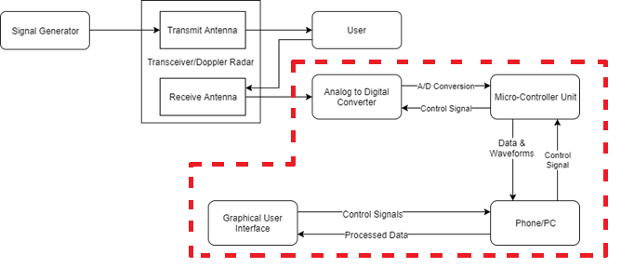
Block Diagram

Slide 7
Target Specifications
ADC Specifications
MCU Specifications
Feature | Specification
Bits of resolution | >= 16
Number of Channels | 8
Sampling Rate | >=1000 samples/second
Power Supply | < 5.0V
Size | Nothing specific, but able to be portable
Feature | Specification
SPI data rate | > 24 kB/s
Microcontroller to PC interface | USB >= 2.0
Data Processing Ability | Dedicated Floating Point Unit
Power Supply | < 5.0V
Size | Nothing specific, but able to be portable

Slide 8
Target Specifications (continued)
PC and Signal Processing Specifications
Feature | Specification
Software requirements | MATLAB >=2017a
Operating System | Windows 7+
Communications Port | USB >= 2.0
Data Processing Ability | Real-time signal processing
Display and Plotting Capabilities | Real-time plotting of analyzed data
Size | Nothing specific, but able to be portable

Slide 9
Design Approach (Device Side)
Communication Between ADC and MCU
Will get SPI working on ADC and MCU and confirm that SPI has adequate speed.
MCU data handling
Program MCU to mediate data transfer between ADC and PC.
Will determine an encoding method for data transfer over the COM port.
Communication Between MCU and PC
Will get virtual COM port working between the MCU and PC and confirm that the protocol has an adequate data transfer rate.

Slide 10
Design Approach (PC Side)
Extend current plotting and analysis to analyze and display real-time data.
Will use MATLAB for analysis and either MATLAB or Python for plotting.
User Interface
Improve usability and add additional options, such as selecting which COM port to read.
Create basic Android application to fetch and display analyzed user data.

Slide 11
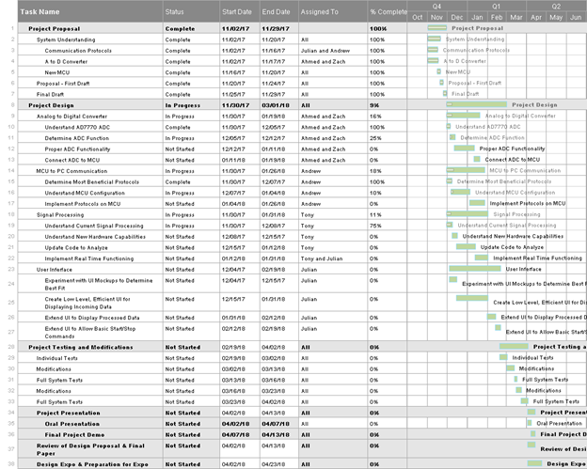
Schedule
Project Design completed by March 1
Project Testing and Modifications completed by April 2
Oral Presentation and Demo given by April 13
Notes:
Andrew

Slide 12
Status
Using an older ADC and present MCU, non-real-time analysis is currently possible with 12 bits of resolution.
Only ~600 samples/second with the newer MCU, a major target is improving it to at least 1000 samples/second.
Important Design Decisions:
Signal processing on the PC as opposed to on the MCU
Using SPI for communication between the MCU and the PC.
Notes:
Andrew

Slide 13
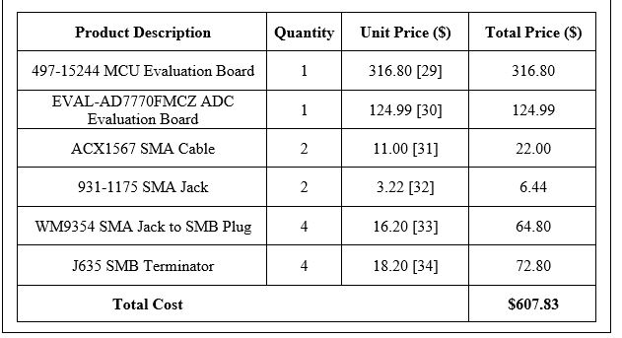
Equipment & Costs For Prototype

