Slide 1
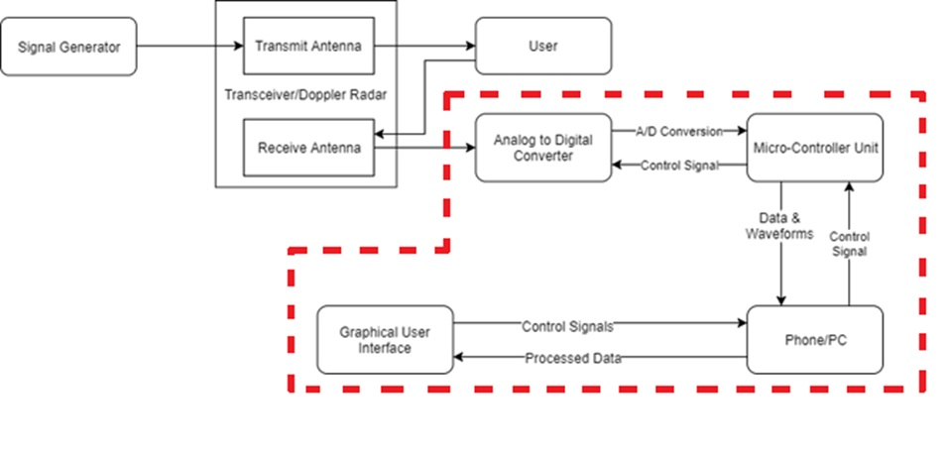
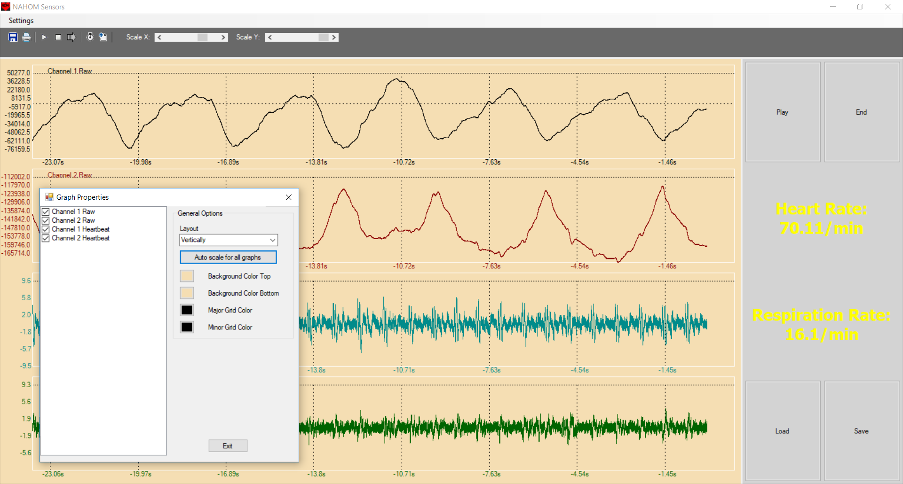
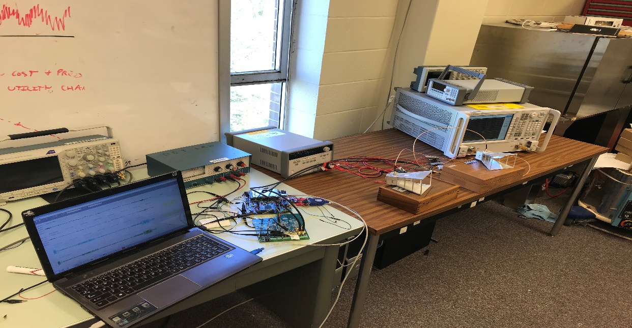
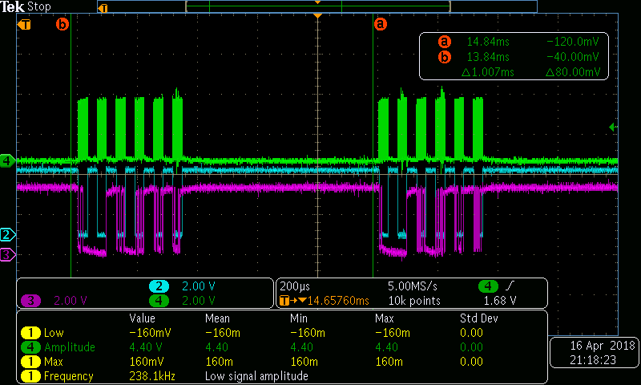
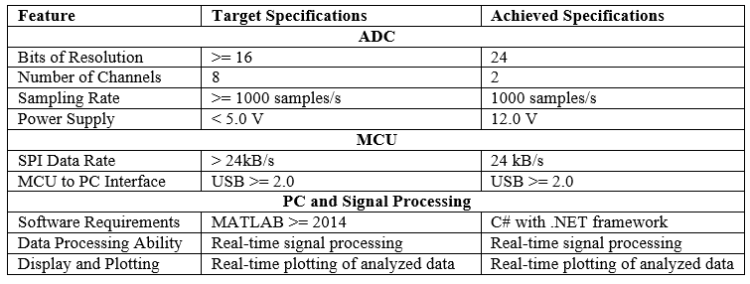
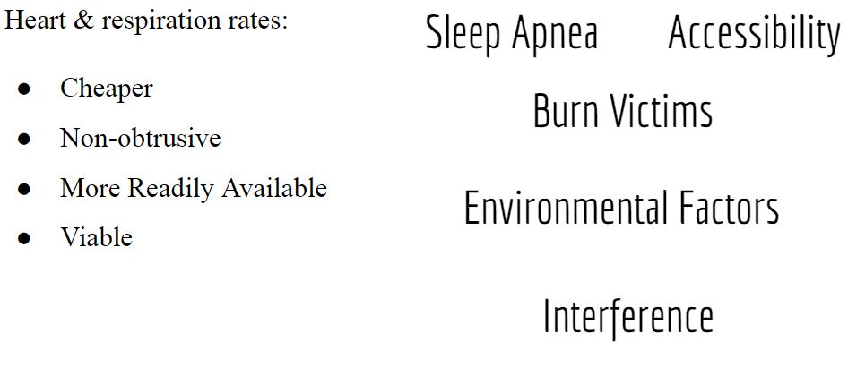
Non-Contact Vital Sign Monitoring System
Ahmed Elsabbagh, Andrew Renuart, Anthony Genutis, Julian Rosker, Zachary Lasater
Advisor: Dr. Ying Zhang
School of Electrical and Computer Engineering, GEORGIA INSTITUTE OF TECHNOLOGY, 777 Atlantic Drive NW Atlanta, GA 30332-0250
Abstract
Objective
MCU to PC
Conclusion
The Non-Contact Analysis of Health-Informatics via Observable Metrics (NAHOM) Team built a device that improves health and minimizes response time in medical emergencies. The NAHOM device serves this purpose by alerting users of certain health emergencies and general health trends without physical contact with the measurement device. It addresses the need for a device that monitors heart and respiration rates in real time without physical contact with the user.
This team is continuing past development efforts for the NAHOM device. A signal generator and a transceiver, with transmit and receive antennas, have been set up by previous teams to extract a signal. The transmit antenna sends a 5.8GHz signal, which is reflected off of the subject’s body to the receiving antenna. The team is responsible for an STM32 microcontroller (MCU) that uses SPI to control an AD7770 analog to digital converter (ADC) to digitize the signal and send it back to the microcontroller. The microcontroller transmits the waveform to a PC through UART and an RS232 to USB connection. The PC processes the waveform and calculates the subject’s biometric data using the frequency components of the reflected signal. The biometric data is displayed to the user in a user-friendly interface on a computer application. The team also developed the signal processing algorithm and the user interface.
The non-contact monitoring system measures and extracts an analog vital sign. Therefore, the main project work will include:
Sampling this signal
Analog to Digital Conversion
Transmitting the data to a computer/microcontroller
Processing the data
Displaying the results
A user interface for the user to control the system.
MCU Data Handling
Programmed to mediate data transfer between ADC and PC
Encoded data transfer via COM port
GUI Analytic Methods:
Continuous Real-Time Analysis
Scheduled Real-Time Analysis
Post Processing
Configurable Time or Frequency Domain Analysis
The project was successfully completed, although a few of the target specifications were not met. Explanations for the switch in specifications are provided below:
Number of Channels: As the project progressed, the group realized only 2 channels were need to accomplished real-time processing.
ADC Power Supply: The power supply for the ADC needed to be increased to 12.0V in order to ensure a clean signal going in and out.
Signal Processing Software Requirements: The signal processing was handled in C# to decrease the final product cost, increase portability of the device, and decrease the total number of dependencies.
What’s Next?
Figure 1. Block diagram of the entire system, with the back-end circled in red
Remove redundant reads in the ADC to allow for a higher sampling rate
Send data from the MCU to the PC on its own thread, separate from the receiving data
Improve signal processing to achieve better resolution
Components
Motivation
Signal Generator
Antennas
ADC
MCU
PC software and GUI
Communication Protocols
Figure 3. GUI displaying each of the channels' respiration and processed heartbeat data.
Results
There are 735,000 cardiac arrests in the United States yearly [1]
65% of cardiac arrests are not immediately detectable leading to a 1.5 hour delay on average [1]
26% of adults suffer from sleep apnea [1]
Respiration rate is an excellent predictor of a wide array of many medical issues [2], [3]
All requirements were satisfied except the ADC power supply, the number of ADC channels, and the software requirement for the processing. These requirements were deemed unnecessary or not important as the project developed.
ADC to MCU
Bibliography
[1] Center for Disease Control and Prevention. (2017, Aug. 24). Heart Disease Facts. [Online]. Available: https://www.cdc.gov/heartdisease/facts.htm. [Accessed: Nov. 25, 2017].
[2] M. A. Cretikos, R. Bellomo, K. Hillman, J. Chen, S. Finfer, and A. Flabouris, “Respiratory rate: the neglected vital sign,” The Medical Journal of Australia, vol. 188, no. 11, 2008. [Online serial]. Available: https://www.mja.com.au/journal/2008/188/11/respiratory-rate-neglected-vital-sign. [Accessed Nov. 25, 2017].
[3] Y. S. Lee, P. N. Pathirana, C. L. Steinfort, and T. Caelli, “Monitoring and Analysis of Respiratory Patterns Using Microwave Doppler Radar,” IEEE Journal of Translational Engineering in Health and Medicine, vol. 2, October, 2014. [Online serial]. Available: http://ieeexplore.ieee.org/stamp/stamp.jsp?arnumber=6942141. [Accessed Nov. 25, 2017].
Figure 2. Oscilloscope capture of sampled signals from the ADC to the MCU with a 1000 samples/sec sampling rate

