Slide 1
TEAM HYDRA
Swimming Swarm Team 1
Priyansh Bhatnagar, Trevor Jones, Hemanth Koralla, Aneri Muni, Vishnu Perumal, Michael Tatum

Slide 2
Vision
Objectives
Develop a swarm robotics system of six autonomous underwater vehicles (AUVs) that would aid in the search and retrieval missions for flight recorders
Design and prototype a system that will allow six robots to collaborate with one another in an underwater setting
Specifications
Key Milestones
Select and order hardware 1/24/18
Finalize software 2/22/18
Create control flow 2/28/18
Integrate software and hardware 3/4/18
Tests single robot 3/4/18
Create multiple robots 4/8/18
Test multiple robots 4/22/18
Design expo 4/24/18
Vehicle specifications
Testing Specifications
Approach

Slide 3
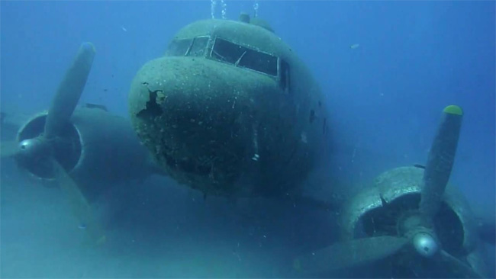
VISION
Flight recorder retrieval is a time-sensitive mission
Aid in search and retrieval missions for flight recorders
How?
Develop six swarm AUVs
Implement leader-follower swarming algorithm to execute underwater search missions

Slide 4
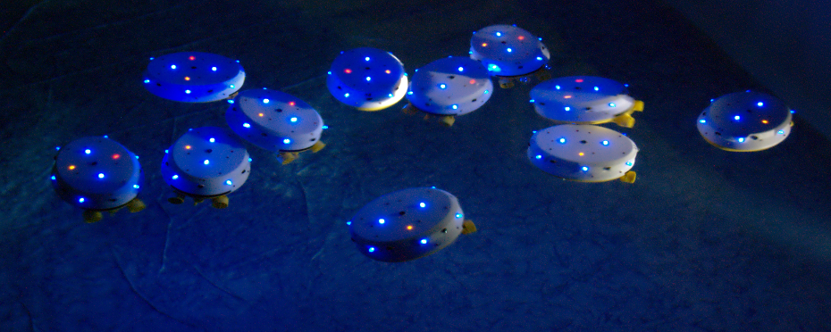
OBJECTIVES
Each HydraBot will:
Listen for pulses from a locator beacon
Maintain formation and move towards signal
Use leader-follower swarming algorithm
Communicate through optical signals

Slide 5
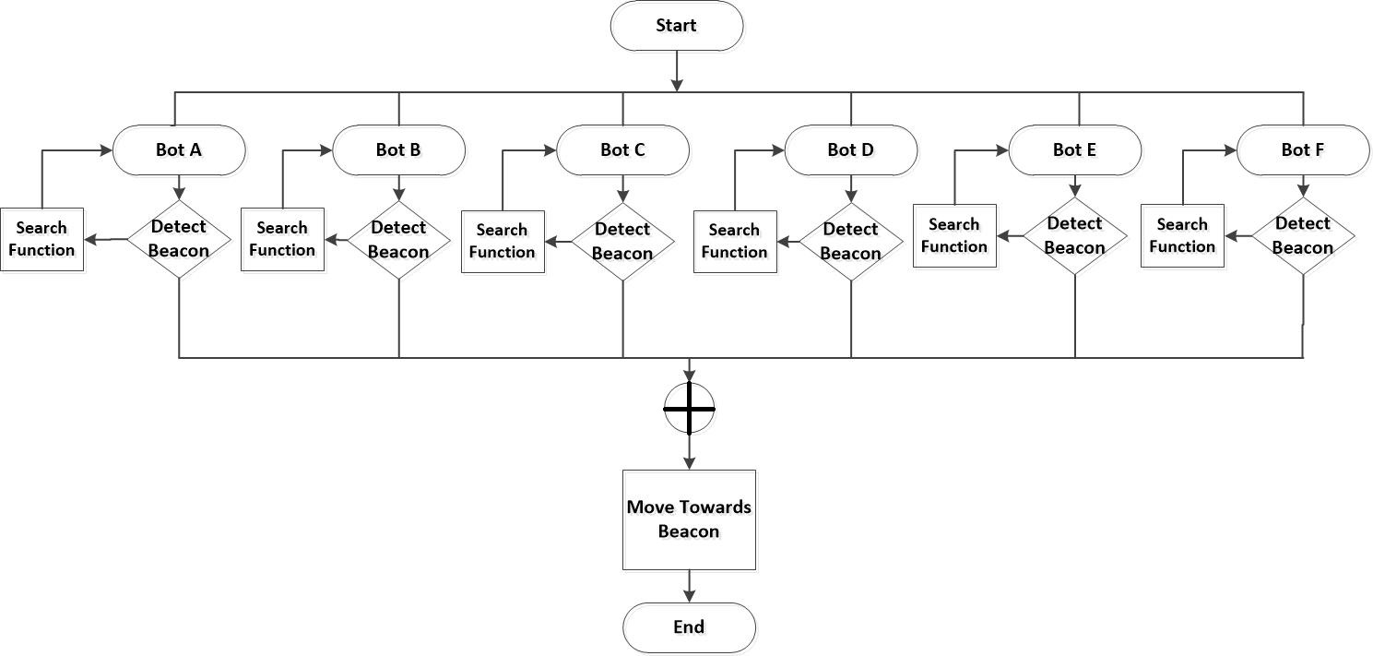
OVERALL WORKFLOW
Notes:
Testing implementation workflow.
This flowchart describes the overall workflow of our search algorithm.
Each Hydrabot is continuously trying to detect the beacon signal from an aircraft’s blackbox
If there is no signal, the swarm moves in a predefined formation, so as to have maximum area coverage
We will implement a leader-follower algorithm
Since there’s no simple was a mapping underwater regions, the leader follows a linear trajectory to search the given space

Slide 6
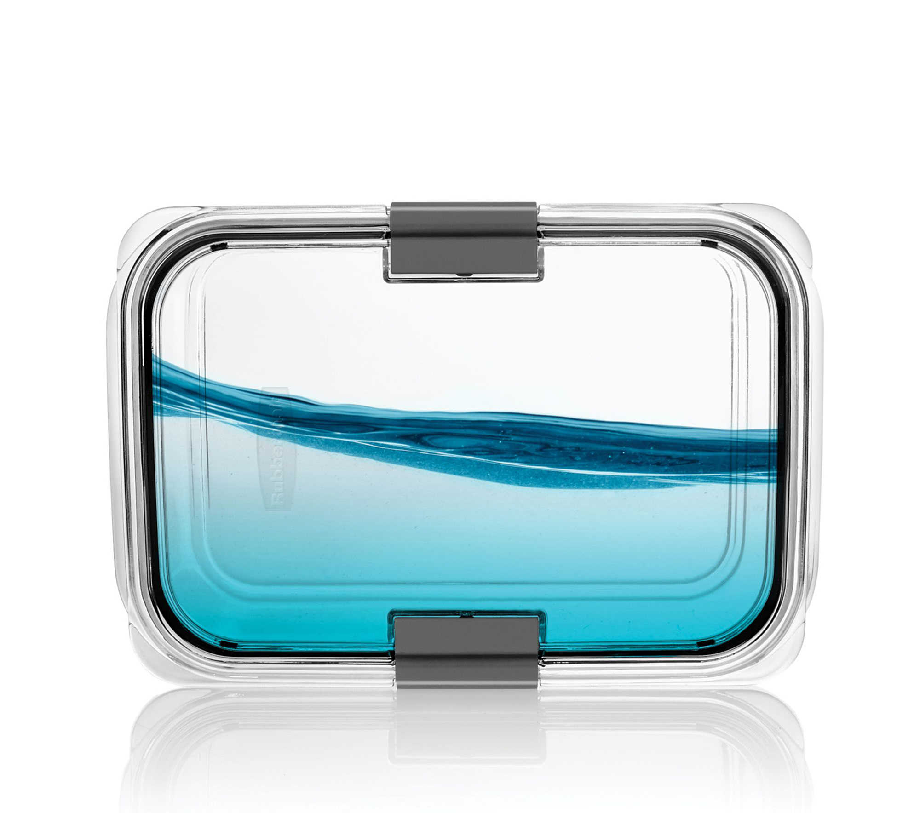
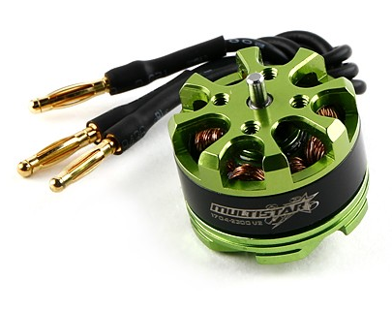
SPECIFICATIONS: CHASSIS AND ACTUATORS
Tupperware Enclosure
Price: $7.99
Purpose: Waterproof enclosure for all electronics
Specification: 7.9" L x 5.4" W x 2.5" H
Underwater DC Motor
Price: $30.00
Purpose: To move the propellers
Specification: 25A, 230V, 30000rpm
Notes:
Aneri

Slide 7
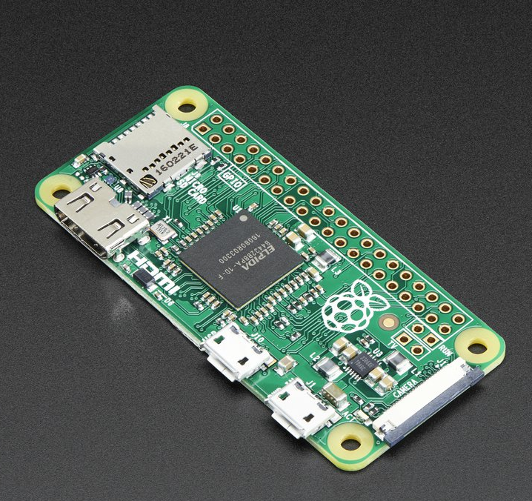
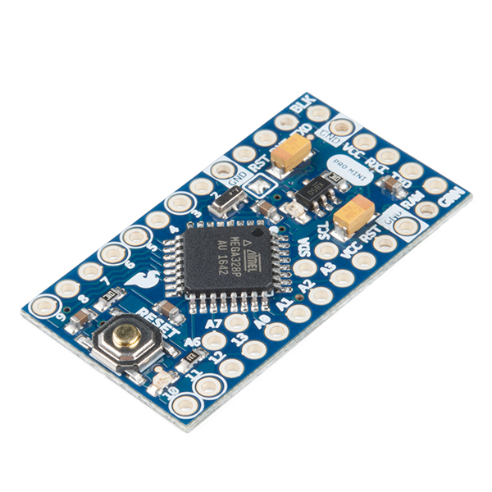
SPECIFICATION: CONTROLLERS
Raspberry Pi Zero
Price: $5.00
Purpose: Main processor
Specification: 512MB SDRAM, 1GHz ARM11 core, 40-pin GPIO
Arduino Pro Mini
Price: $9.95
Purpose: GPIO expander
Specification: ATmega328, 150mA, max 12V
Notes:
Aneri - The Arduino is in charge of the sensing, actuation(i.e. propulsion of the thrusters) and lastly control systems which help realise our autonomous behaviour. The Raspberry Pi is in charge of high level algorithm control. It performs the more computational and memory intensive work. You can think of it as a master-slave relation where the Arduino is the supervisor of all sensors connected to the Pi.

Slide 8
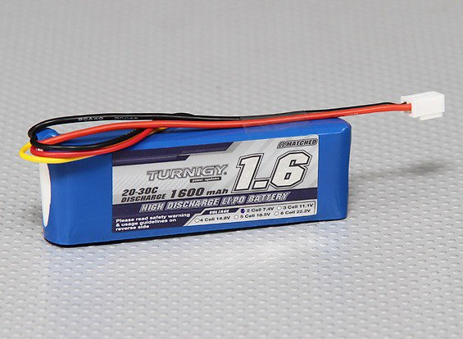
SPECIFICATION: POWER
Lipo Pack Battery
Price: $7.64
Purpose: Power Raspberry Pi, Arduino Pro Mini, and motors
Specification: Turnigy 1600mAh 2S 20C (discharge rate)
Battery Life: ~30 min
Notes:
Aneri

Slide 9
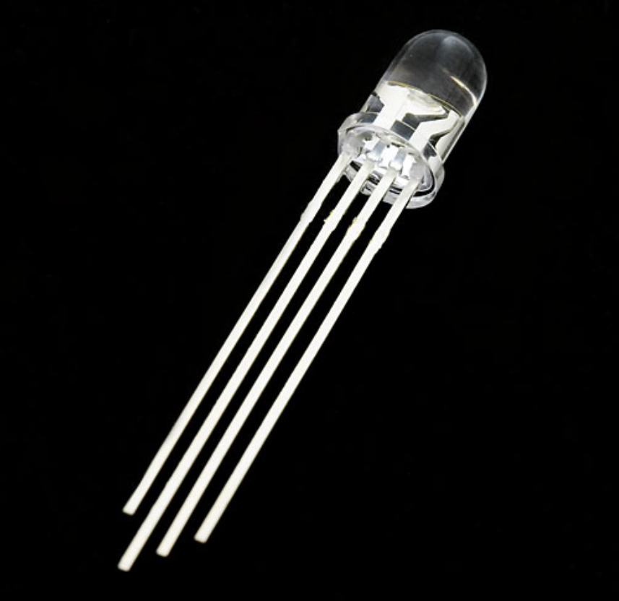
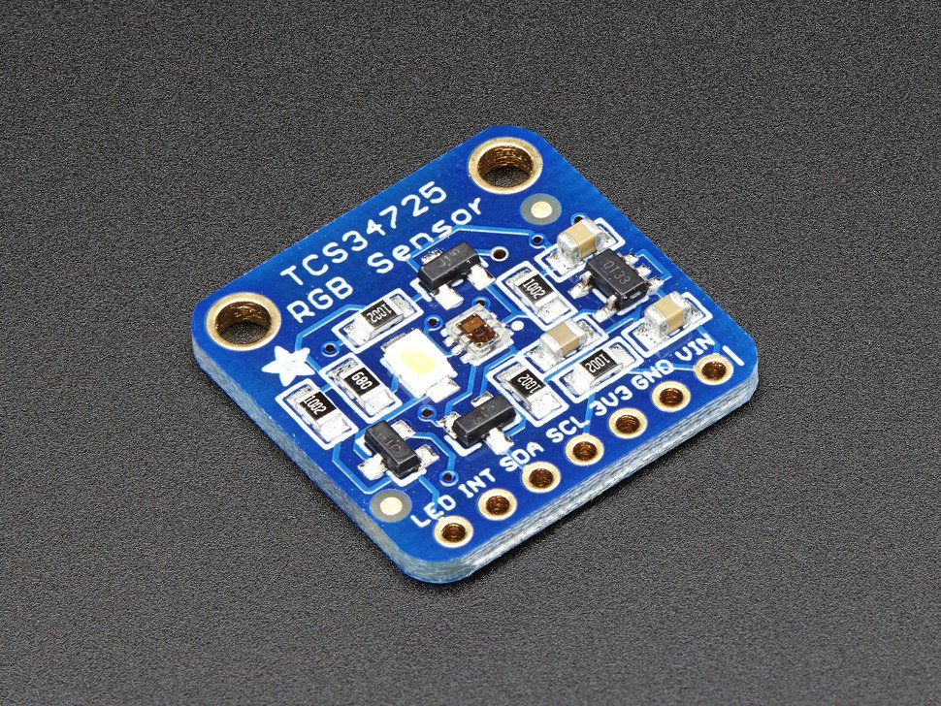
SPECIFICATION: COMMUNICATION
RGB LED
Price: $1.95
Purpose: Send signals through different colors
Specification: 2.0V (R), 3.2V (G), 3.2V (B)
RGB Color Sensor
Price: $7.95
Purpose: Detect different colors
Specification: 5V max input, light-to-frequency converter reads an 8 x 8 array of photodiodes.
Notes:
Hemanth

Slide 10
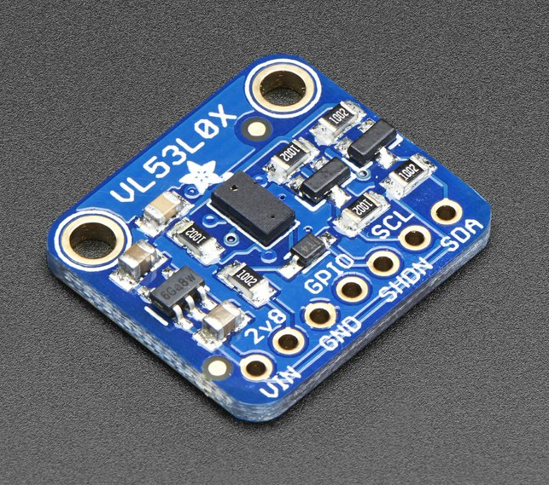
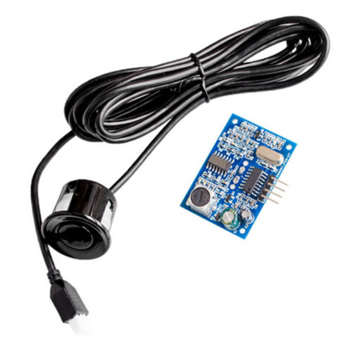
SPECIFICATION: SENSORS
Time-of-Flight Sensor
Price: $14.95
Purpose: Distance measurement to maintain position within swarm
Specification: 50mm to 1200mm of range distance
Inertial Measurement Unit
Price: $24.95
Purpose: Receive feedback to create PID controller
Specification: 9-DOF Accel/Mag/Gyro+Temp
Acoustic Transmitter/Receiver
Price: $10.35
Purpose: Detect the audio beacon of blackbox and move swarm
Specification: 4.5 meter max, 5V max
Notes:
Hemanth

Slide 11
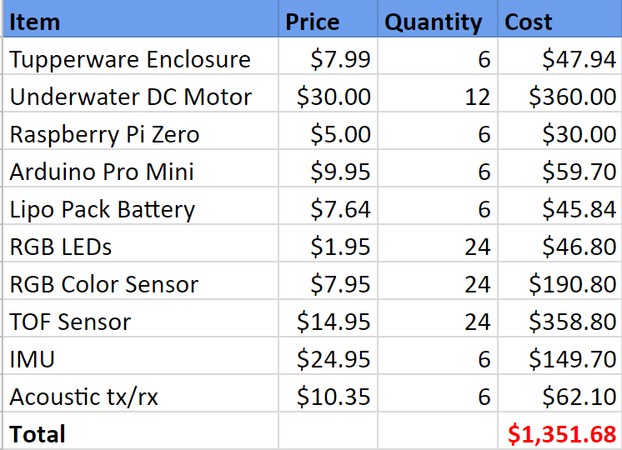
TOTAL COST ESTIMATE
Notes:
Hemanth

Slide 12
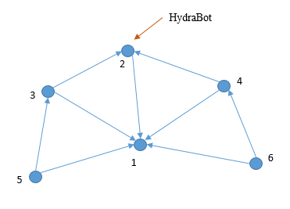
SPECIFICATION: SWARMING ALGORITHM
Decentralized control algorithm
No central communication unit (“God’s eye view”)
Communication between immediate neighbors
Maximally-spanning configuration
Mixing formation control and leader-follower coverage control
Notes:
Mike

Slide 13
FORMATION CONTROL

Slide 14
LEADER-FOLLOWER

Slide 15
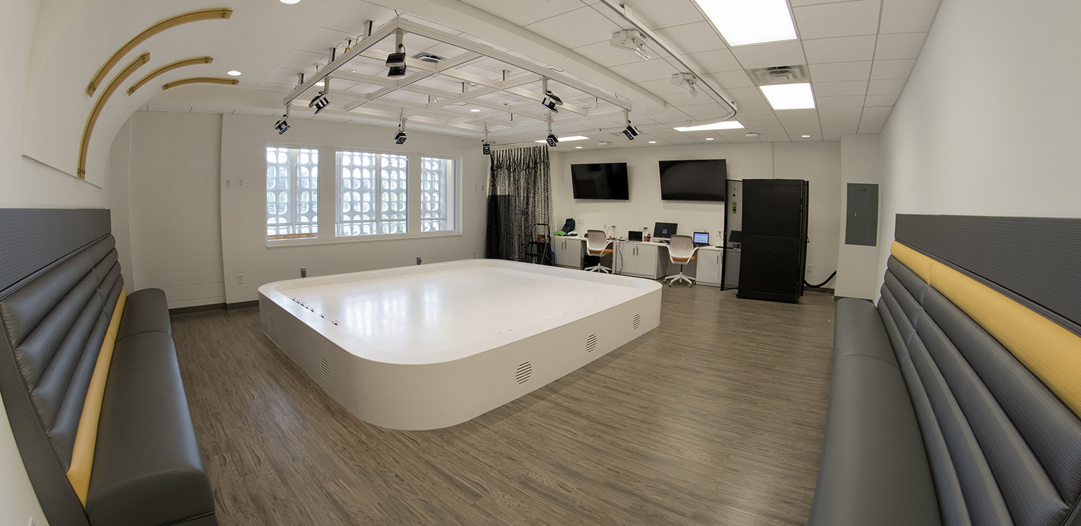
TESTING
Georgia Tech's Robotarium provides simulation tools and surrogate platforms to test swarming algorithm
Completed HydraBots will be tested in a shallow children’s pool or the J. Erskine Love Building pool
Notes:
Mike

Slide 16
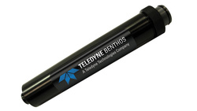
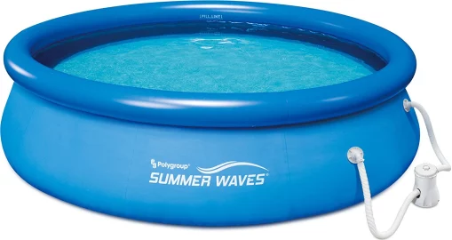
TESTING
Acoustic pinger will act as the beacon from the flight recorder
In the process of finding an acoustic pinger to use. Potential sources:
Woodruff Building of Mechanical Engineering
Dr. Ji-Xun Zhou: Principal Research Scientist in Acoustics and Dynamics
Notes:
Mike

Slide 17
SCHEDULE: HARDWARE SELECTION
Notes:
Priyansh

Slide 18
SCHEDULE: SOFTWARE
Notes:
Priyansh

Slide 19
SCHEDULE: CONTROL FLOW
Notes:
Priyansh

Slide 20
SCHEDULE: HARDWARE/SOFTWARE INTEGRATION
Notes:
Priyansh

Slide 21
SCHEDULE: MULTIPLE ROBOTS
Notes:
Priyansh

Slide 22
SCHEDULE: DELIVERABLES
Notes:
Priyansh

Slide 23
CURRENT PROJECT STATUS
Finalized all the parts, components and major design features.
Met with Dr. Magnus Egerstedt to determine suitable coverage control algorithms for multi-agent systems used for beacon detection.
Method to acquire distance measurements underwater and the development for underwater communication protocol still needs to be researched and tested.
Reached out to Dr. Ji-Xun Zhou, Georgia Tech’s Principal Research Scientist in Acoustics and Dynamics, for an acoustic pinger.
Notes:
Priyansh

Slide 24
Thank you
QUESTIONS?
Notes:
Priyansh

