Slide 1
Newtonian iot uniform
Daniel albuquerque
JIWON LEE
Olatide Omojaro
Drevon taylor
Aaron thurston
Kevin Webb

Slide 2
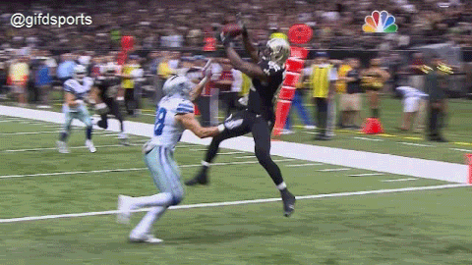
Areas of focus
Players sustained 271 concussions in 2015, an increase of 31.6 percent over 2014.
Head injuries in regular season games alone surged 58.2 percent, from 115 to 182.
Both figures were the highest in the last four years, according to the NFL.
Concussions are often compiled with additional injuries during play

Slide 3
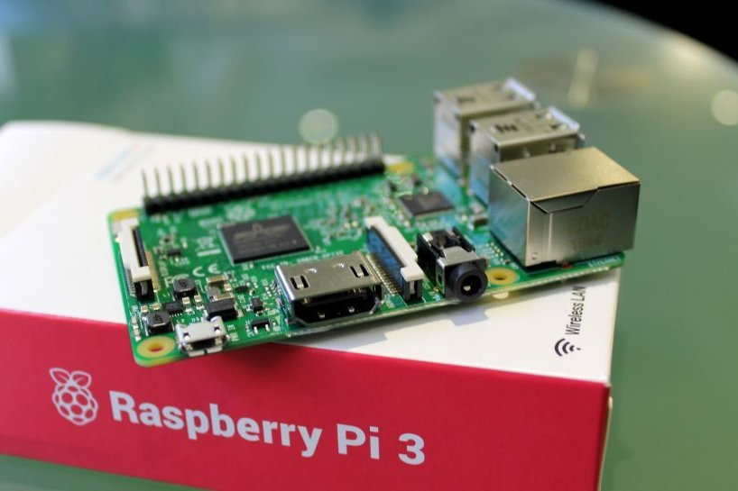
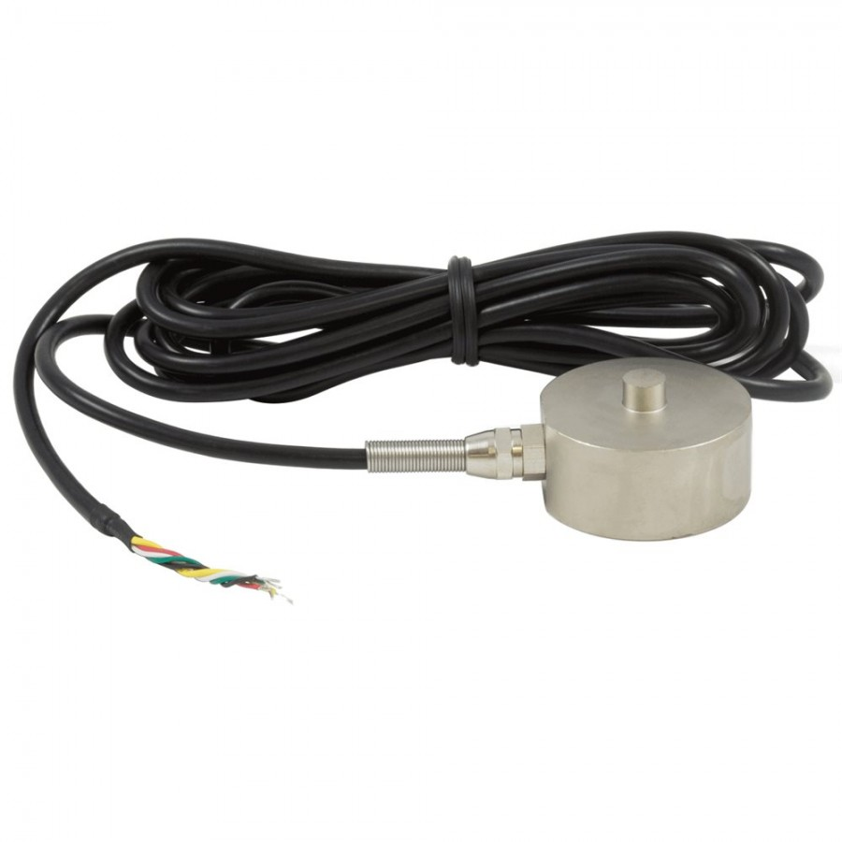
Materials and cost
Rasberry Pi 3 ~ $ 35
Champro AMT-1000 Varsity Football Shoulder Pad ~ $ 85
Schutt Vengeance V-EGOP-II-TRAD Adult Facemask ~ $250
Flexi Force Sensors ~ $ 40
Load Cell + Amplifier ~ $ 110
Accelerometer ~ $ 12
Pulse Sensor ~ $ 25
The group went slightly over the initial budget of $ 500 but the excess amount was covered by the Electrical and Computer Engineering Department of Georgia Institute of Technology.

Slide 4
Assembly process
Chest Pads:
Two polycarbonate mounting plates, one in the chest and another in the back. Embedded are:
2x Load Cells (chest)
Rasberry Pi 3 (back)
2x FlexiForce Sensors
Helmet:
Accelerometer located at the forehead where greatest impact typically occurs.
Electrical tape for wire bundles and routing to the back of the neck.

Slide 5
functionality
Real-time sensor data
(MAURICE Suit)
Device
(MAURICE Web-App)
request
API
(AWS API Gateway)
publish sensor data
response
user authorization request
post real-time data
Account microservice
(AWS Cognito)
Data Streaming Microservice
(AWS Lambda, Firehose, SNS, S3, ElasticSearch)
user authorization response
get real-time data

Slide 6
Dashboard interface
Provides graphical analysis tools for each sensor
Medical staff can observe the most recent hit as well as the cumulative force withstood over the course of the game.

Slide 7
Cloud layer
Queue ​ | AWS Simple Queue Service (FIFO) ​
Server(less) Architecture​ | AWS Lambda​ AWS Elastic Compute Cloud​ AWS Elastic Beanstalk​ AWS Firehose​ AWS S3​ AWS Cognito​ DynamoDB (NoSQL) database​
Data Handling (10 or less concurrent users) ​ | 3 Web Servers (2 cores, 8 GB RAM, 500 GB storage/ea.)​ 2 App Servers (4 virtual cores, 16 GB RAM)​ 15 GB Data transfer​ 30 GB Data Storage and Backup​

Slide 8
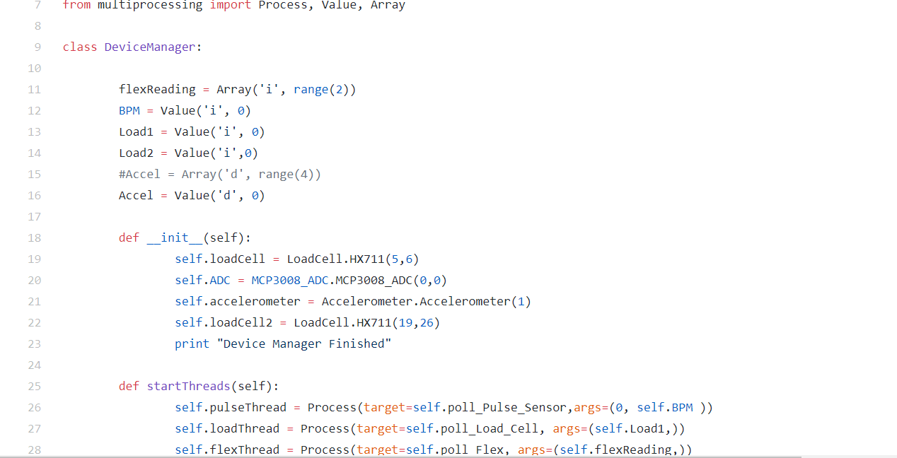
Embedded software

Slide 9
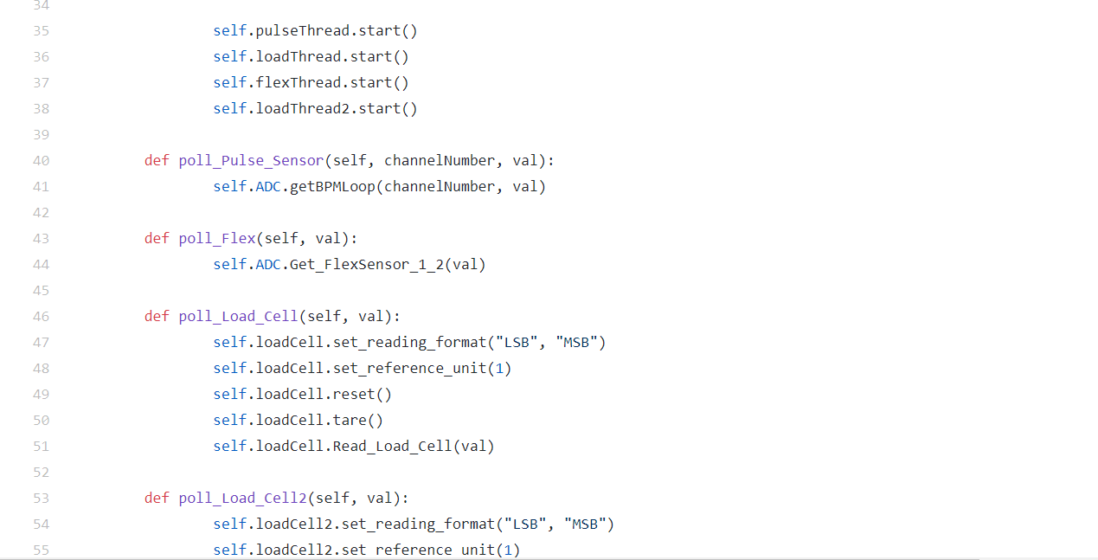
Embedded software

Slide 10
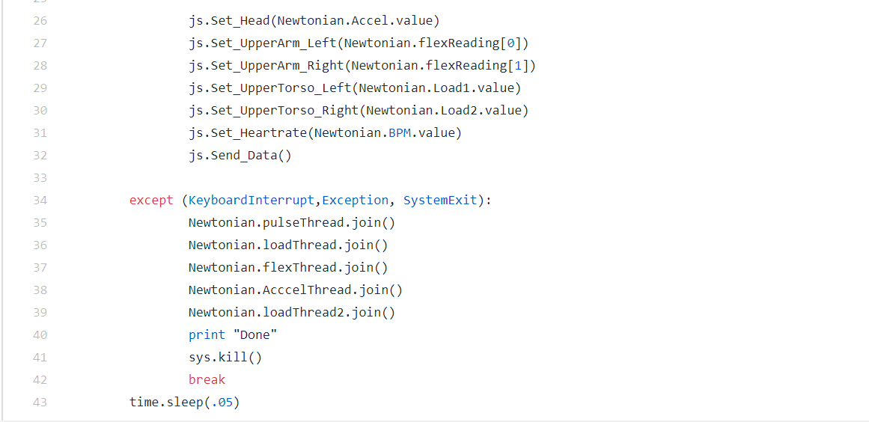
Embedded software

Slide 11
results
The Load Cells recorded the most accurate measurements on impact.
The heartrate sensor produced skewed results due to calibration issues
Missed readings can be attributed to short duration of impact relative to refresh.
The average time to communicate from the raspberry pi to the cloud ~ 0.3-0.5 sec.
Flexi Sensors are inconsistent.

Slide 12
Future improvements
Improve network reliability. Problems can occur with the application If the upload speeds are too slow.
Address wi-fi security issues with Apple devices.
Calibrate heart rate sensor for more accurate results
Include load cells capable of detecting a higher range of force upon impact

Slide 13
Future improvements
Make a compact PCB
Add more accelerometers to get higher resolution readings for concussion sensing(linear and rotational)
An array of accelerometers in the helmet, evenly spaced.

