Slide 1
SkyIsland: Aerial Docking Drone System
Latifah Almaghrabi, Adrian de la Iglesia Valls,
Ayca Ermis, Jiaqing Li, and Lingfeng Zhou
ECE 4012 Team: SkyIsland
School of Electrical and Computer Engineering
Georgia Institute of Technology - College of Engineering
Notes:
Adrian: (Make it short!!!!)
Search and rescue missions -> Challenge (hand in hand but technically different): search (great areas, many sensors) / rescue (one heavy lifting rescuer). What if -> modular aerial platform, so flexible that not only both but many other tasks.

Slide 2
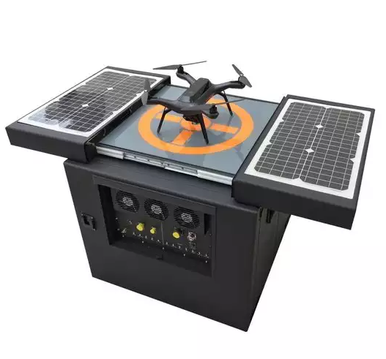
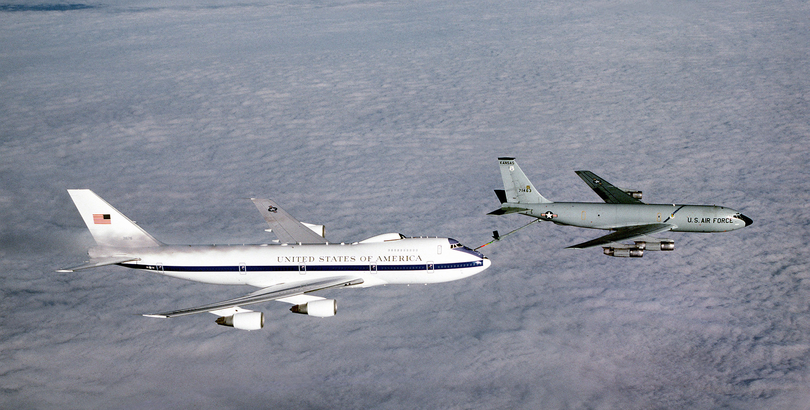
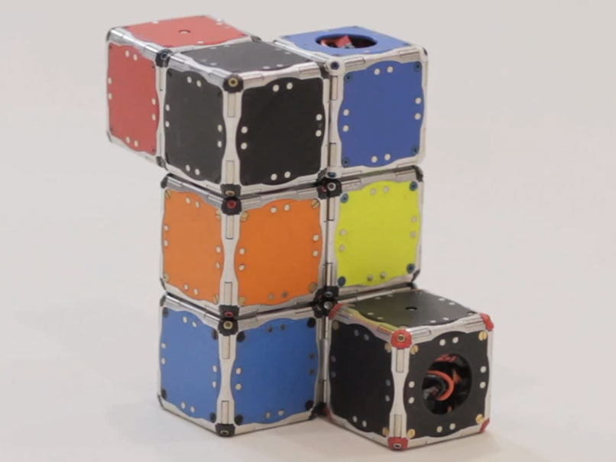
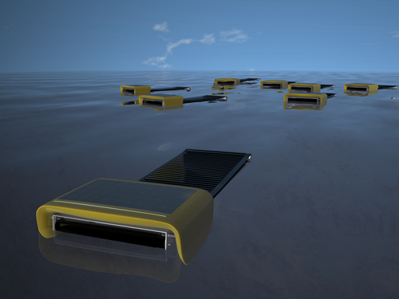
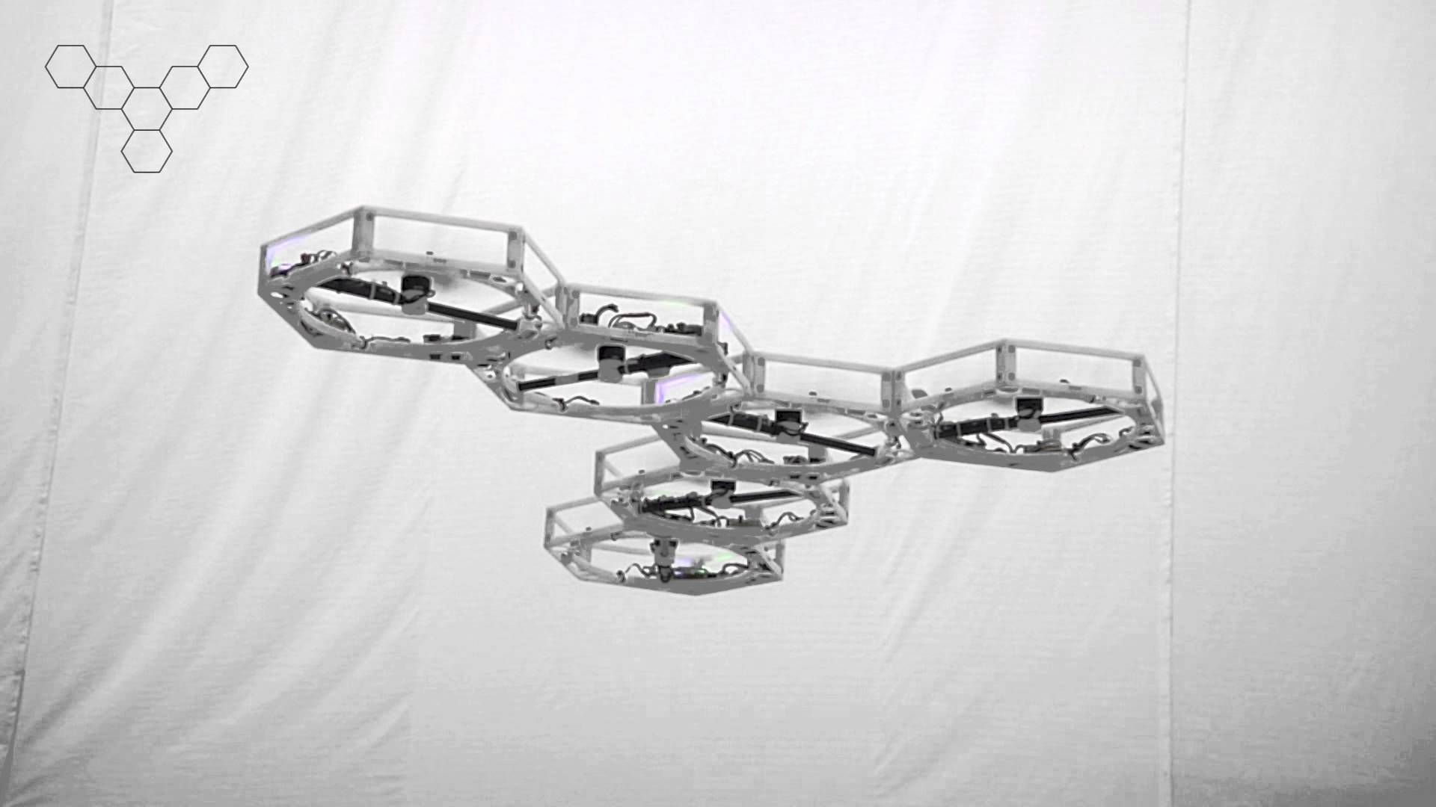
Background
Notes:
Adrian:
what SkyIsland is trying to achieve is unprecedented so we combine key features of different projects.
Drone box: Inspection drones
Mid air refueling (Daniel Briggs Wilson)
MIT M Blocks
Microsoft Cleanflight: Software for laptop base station
MIT: Seaswarm
ETH: Flight Array

Slide 3
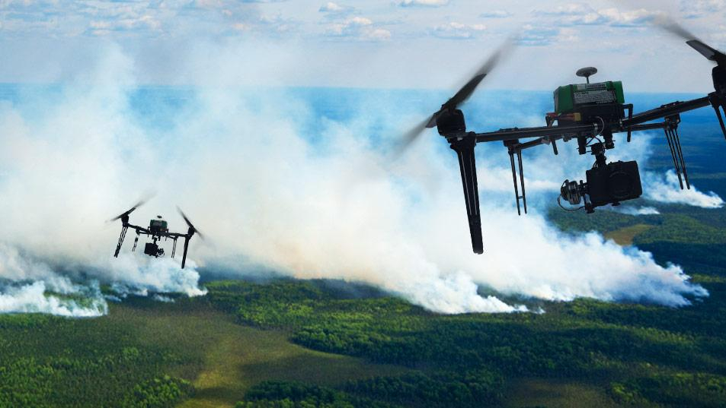
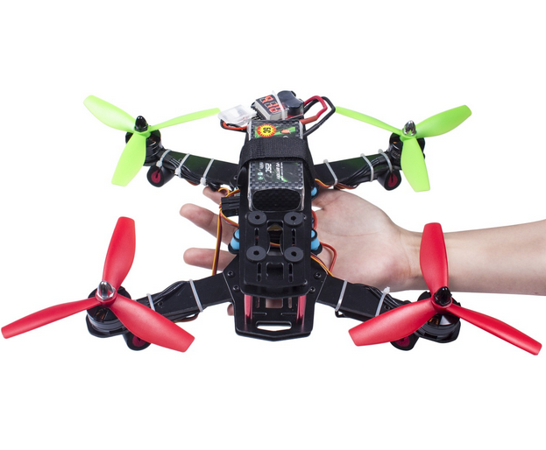
Goals and Specifications
Hardware Feature | Specification
Position Sensor Detection Range | > 10m, >40º
Alignment Sensor Sensitivity | < 1cm
Minimum Re-polarization Magnetic Field | > 50kA/m
Drone-to-Drone Communication Sensor Distance | > 20m
Drone-to-Ground Communication Sensor Distance | ~50m
Flight Time | 5 minutes
Software Feature | Specification
Amount of Command Input | < 12
Bit Rate | 125 kbs/s
Communication Latency | < 250ms
State Precision | ±5cm, ±5º
Stability Correction Rate | > 100Hz
Notes:
Qing:
Functionality of the prototype/model: Two or more drones follow the ground commands, dock and separate in mid-flight and operate as one unit.
Application: Search and inspection
Advantage: Multi-functionality and power efficiency
“execute from ground””

Slide 4
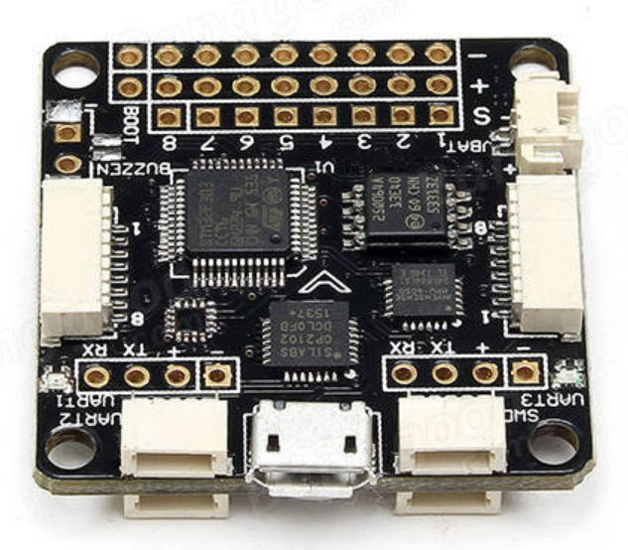
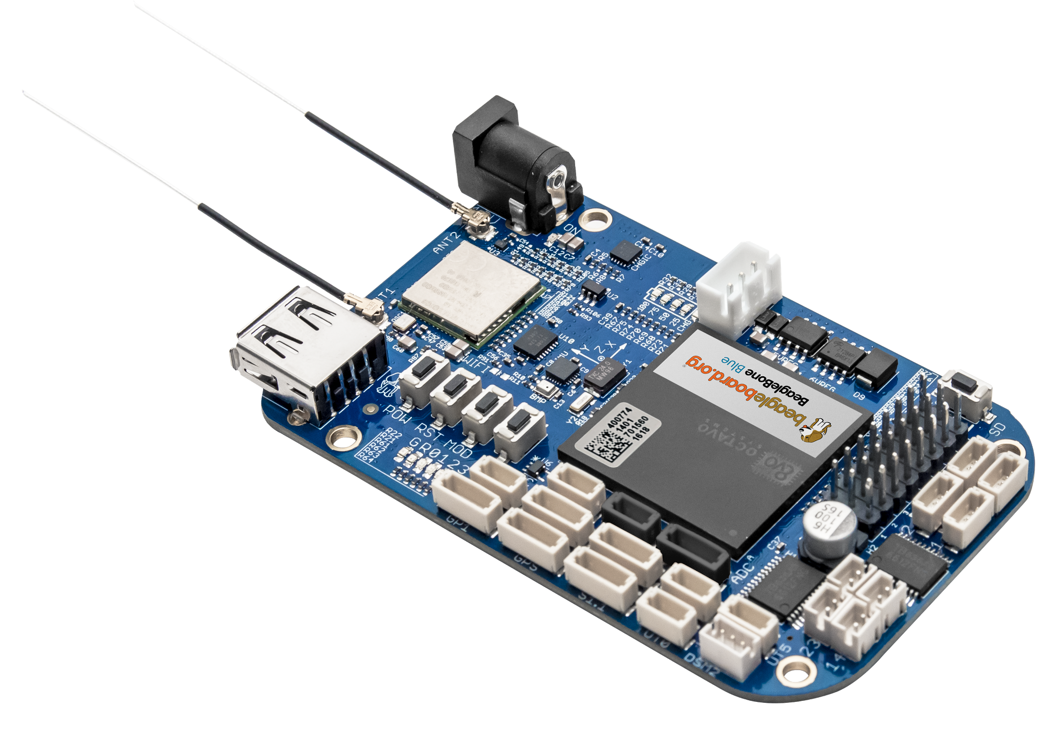
Drone and Microcontroller Features
Microcontroller Compared
 | F3 Controller | BeagleBone Blue
Core | 32-Bit ARM Cortex-M4 | 32-Bit ARM Cortex-A8
Maximum Frequency | 72MHz | 1GHz
Flash Memory | 16 up to 512 kB | 4 GB
RAM | 16 kB | 512 MB
Operating Voltage, VDD | 1.8 V | 6-18 V
Sensors | 6-axis IMU | 9-axis IMU, barometer
F3 Controller
BeagleBone Blue Controller
Notes:
Latifah:
To achieve the goals and specification of the project, our drone of interest is the Crazepony MINI. These quadcopters are appropriate as a choice because they come open source, fully assembled and ready to fly and have excellent features for less than $90. In terms of embedded sensors: the drone has an altimeter in addition to 3-axis gyroscope, accelerometer and digital compass. For communication it comes with RF transceiver and low energy bluetooth MCU. The drone has a 32-bit ARM Mmicrocontroller. To give you a sense of the features of the microcontroller, here is a comparison with MBED microcontroller. The table here compares their frequencies, timers, memories, power modes, and electrical characteristics. As shown there, they’re both 32-bit ARM MCU’s. our MCU runs on a slower clock but can handle 1.5 times the current the MBED can handle. They both offer low power modes which helps to reduce power consumption. Unlike the MBED, our MCU has a specific timer for motor control.
IC MCU 32BIT 64KB FLASH 36VFQFPN

Slide 5
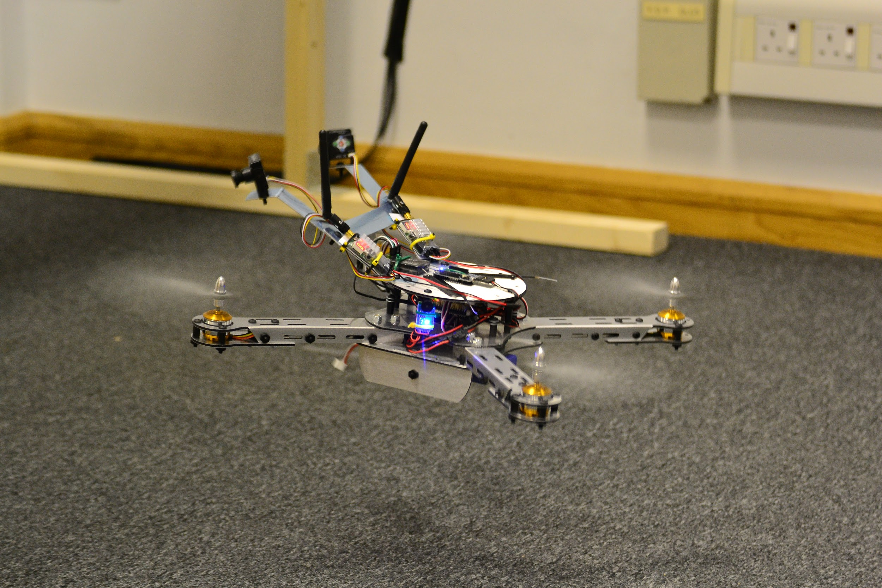
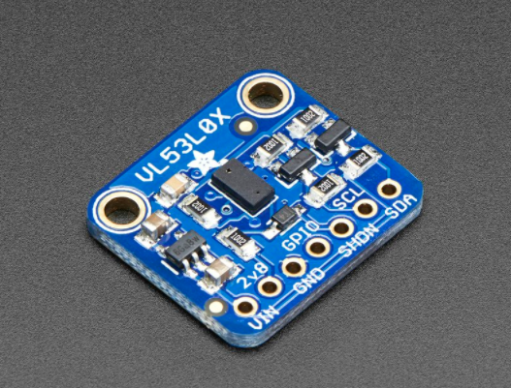
Docking and Positioning Sensors
Far Range Positioning:
Image Processing
and Machine Learning
Close Range Positioning:
AprilTag
and Time of Flight Sensors
Notes:
Qing:
IR:
s is signal strength
L is the distance between the emitter and receiver
a is the gain and beta is the offset
2D scenario

Slide 6
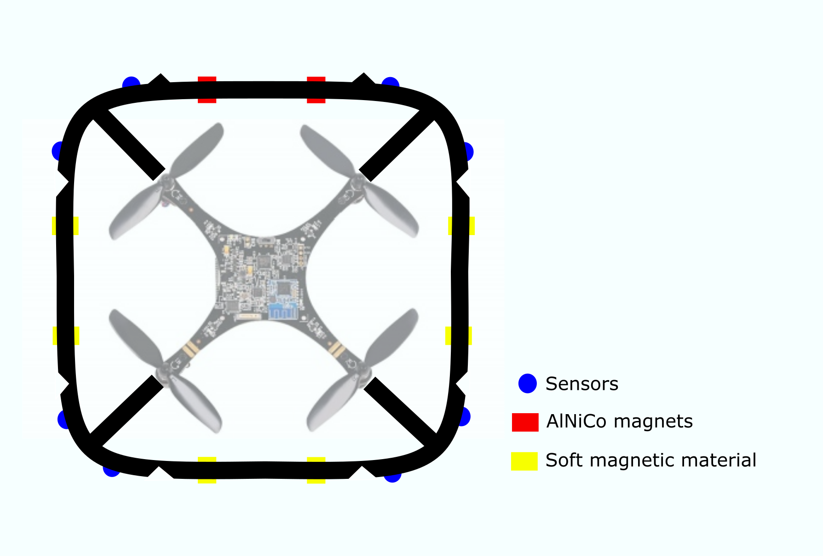
Docking Mechanism
Mechanical Structure
Physics
Control Circuit
Notes:
Latifah:
In case we run into any problems with soft magnetic materials, we’ll implement AlNiCo magnets instead.
Intrinsic Coercivity of AlNiCo = Hci= 152788A/m
lightweight shell
As I have explained a number of slides ago, our drones come fully assembled so to dock a couple of them together, we propose this shell design to host our docking components. The shell will be made out of a light weight polymer and will have one active docking spot and three passive docking spots. An active spot contains a pair of two AlNiCo magnets as shown in your bottom left corner here. A passive docing spot will contain a soft magnetic material. An active spot on a drone links to a passive one on another.A pair of AlNiCo magnets can form what is known as an electropermanent magnet. An electropermanent magnet is magnet with switchable polarity offering two different states as shown in the top right corner. whe the two pairs have aligning magnetic fields, they can attract a doft magnetic material. When their magnetic fileds are not aligned, they do not attract any magnetic material and the magnet is said to be off. the magnetic field of one of the AlNiCo magnets is controlled with a single pulse of current passed through a coil of wire surrounding the magnet. We propose using 4 low power MSFETS to control the direction of flow of current in the coil.
steirofoam

Slide 7
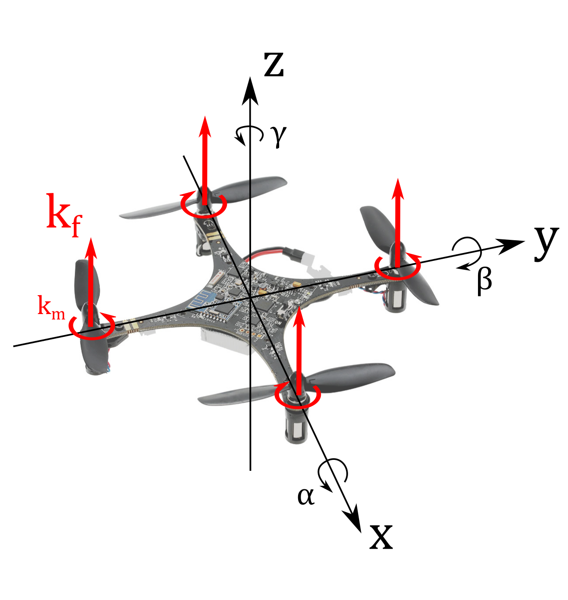
Control System
Matrix Model
The Euler-Newton Equation
Cascade LQR Controller
Notes:
Adrian:
Extending existing model
Position/Orientation/Derivatives
Inputs and extrapolation to any number of rotors
Euler/Newton + Magnetic forces
Optimal control LQR
Improve computational efficiency, cascade

Slide 8
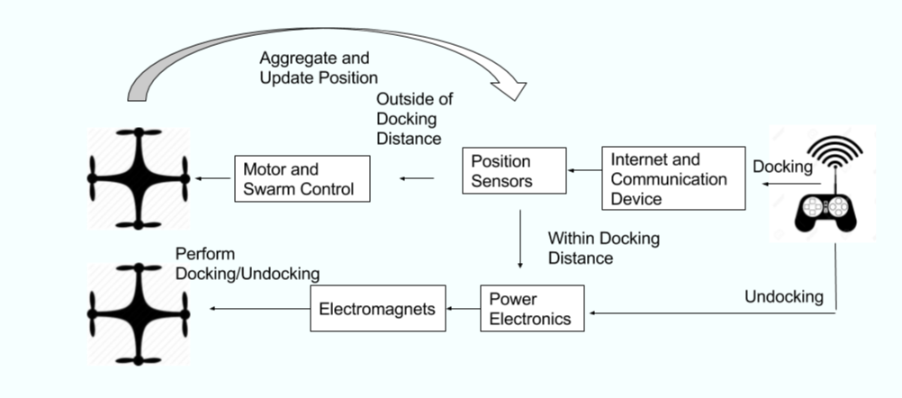
Communication
Notes:
Adrian:
packaged inadequate, so wifi module commonly used
D2D and D2G
diagram

Slide 9
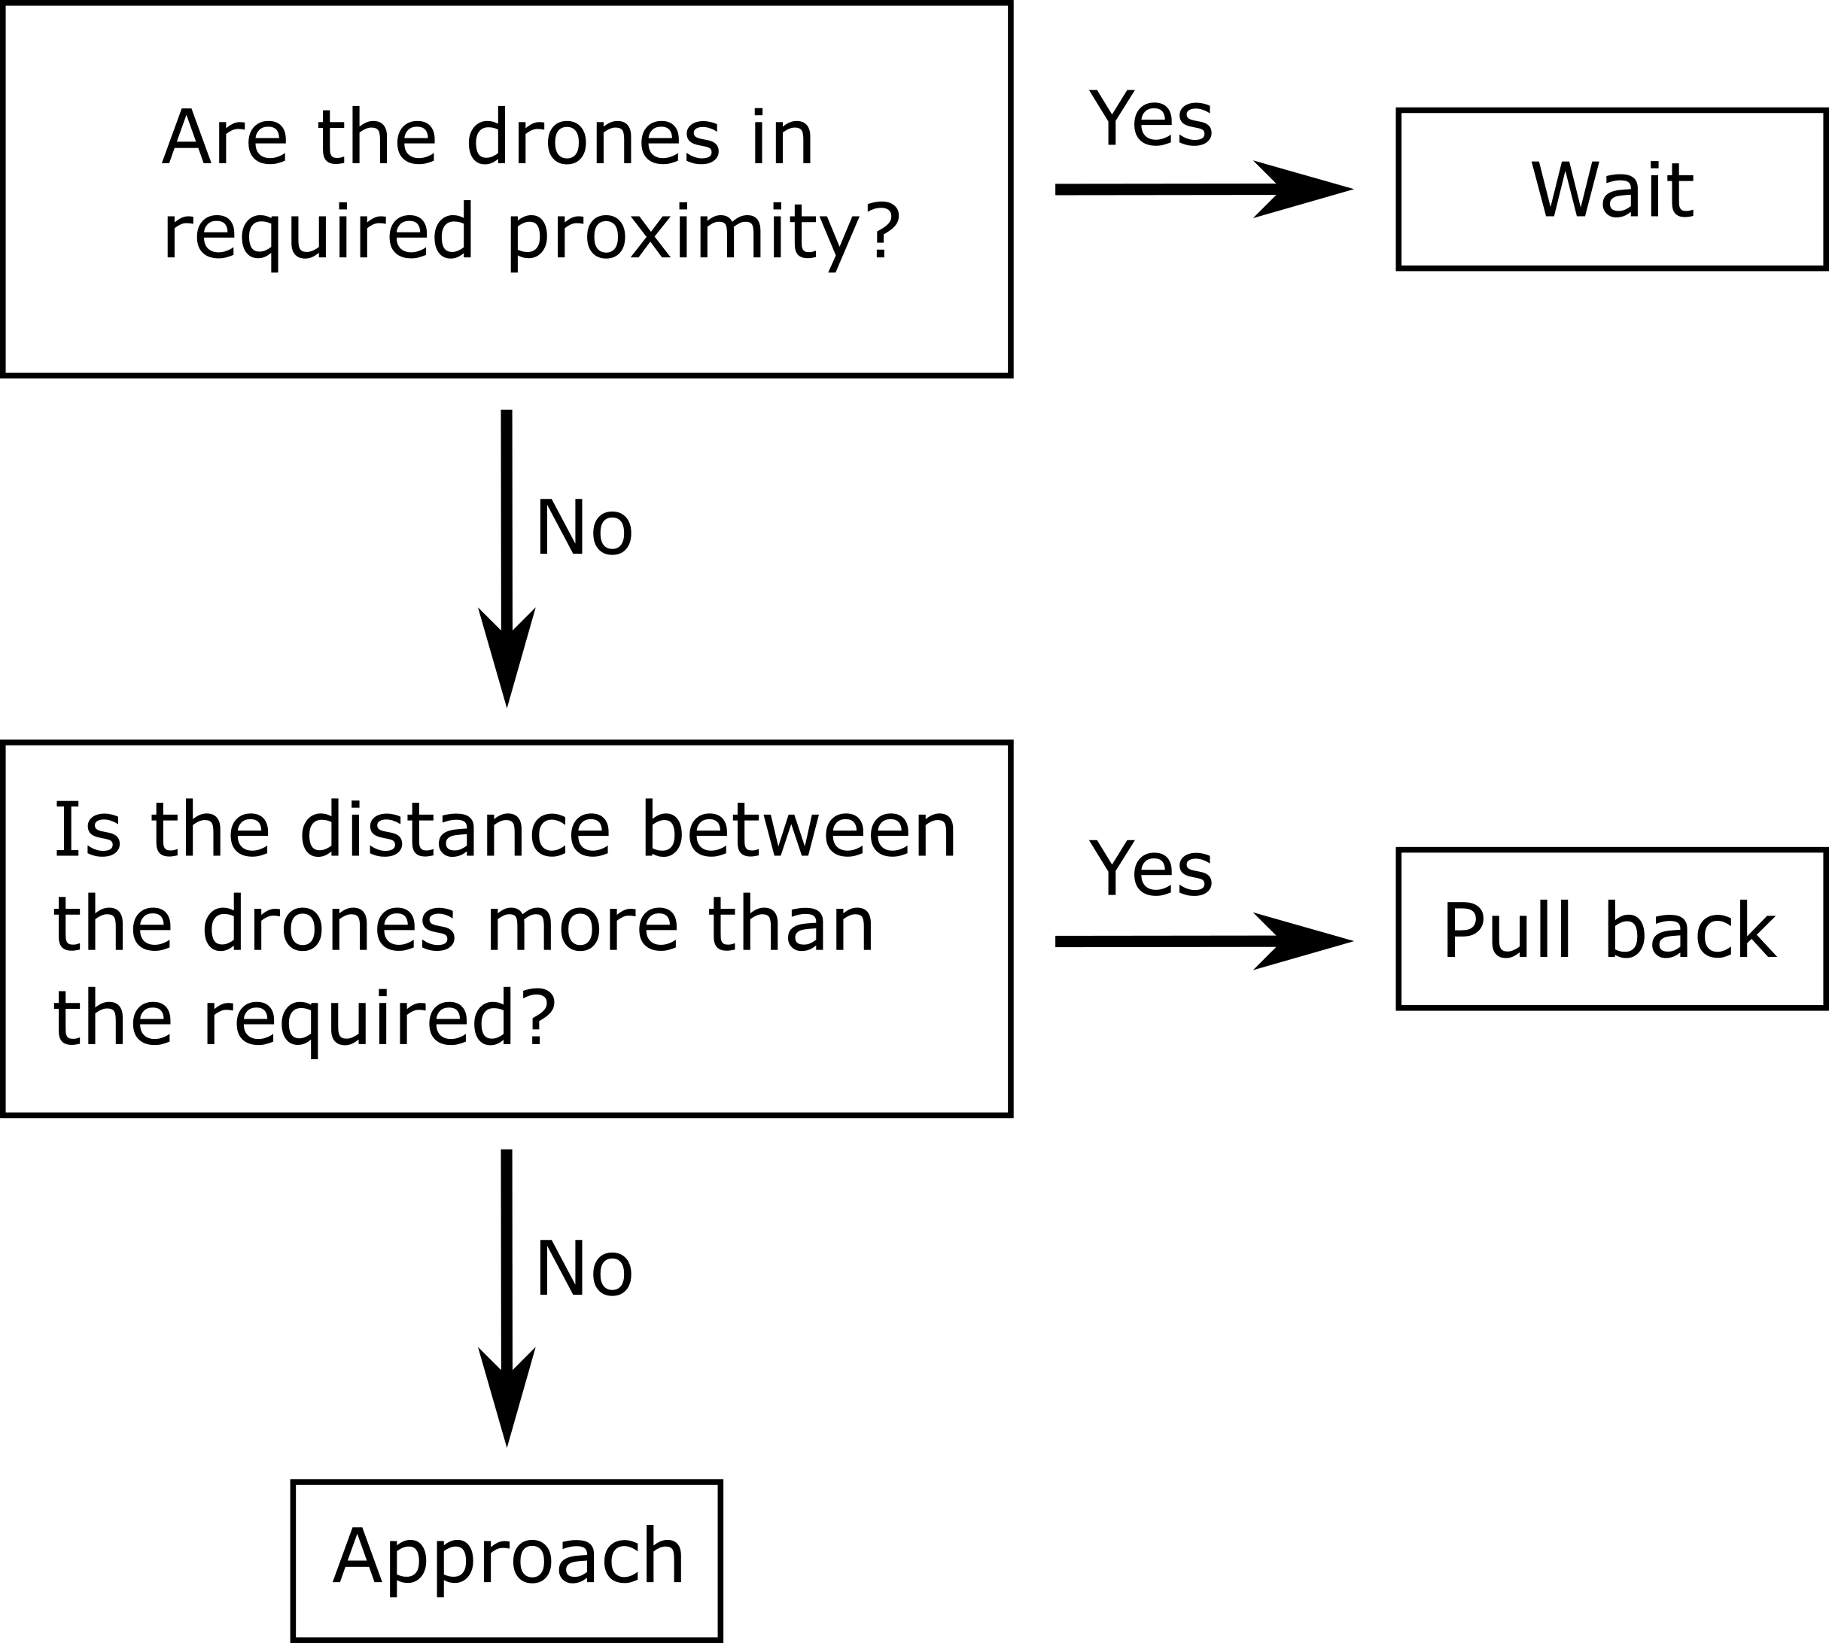
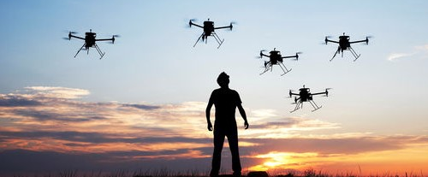
Swarm
Flowchart for Swarm Behavior
Probabilistic Finite State Machine (PFSM)
Notes:
Ayca:
mention prob trans model first

Slide 10
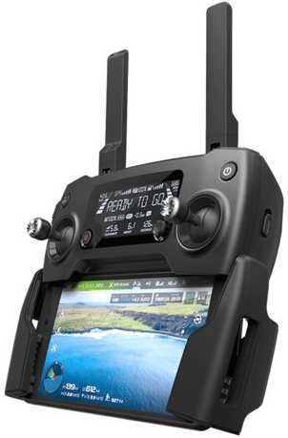
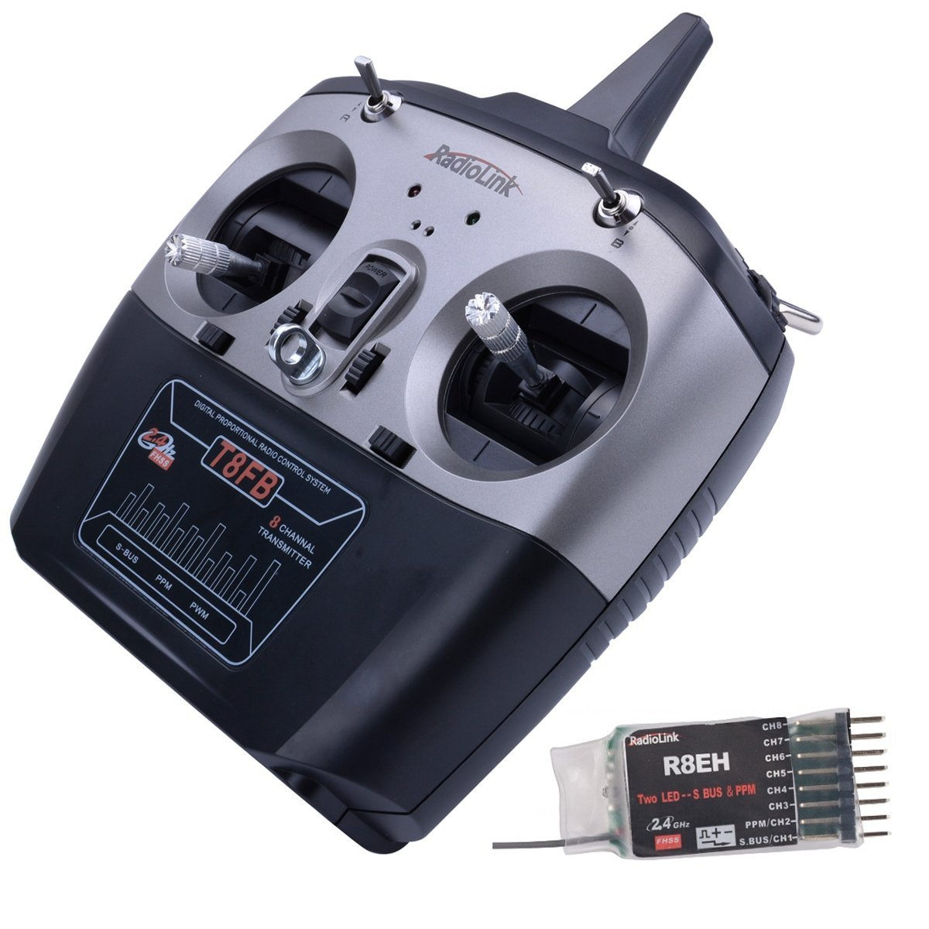
Human Machine Interface (HMI)
Leading Industry Solution
Proposed HMI Solution
DJI Mavic Pro Controller:
Two-Tier HMI
Telemetry LCD
Android/iOS App
Proprietary Firmware
Crazepony RadioLink:
Multi-Tier HMI
Configurable Controller
CleanFlight Compatible
Open Source Firmware
Notes:
Ayca:
interface with android through bluetooth 4
clean flight

Slide 11
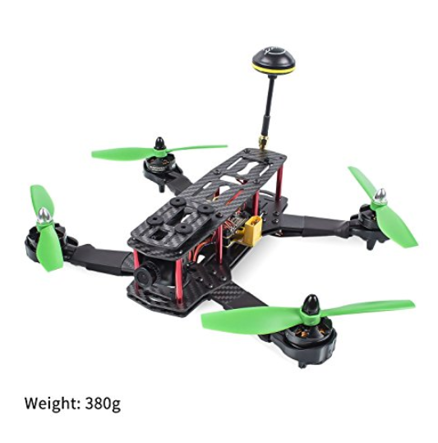
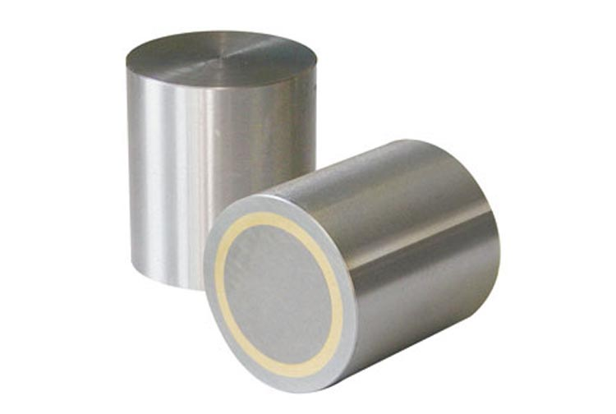
Components
Part | Vendor | Price per Unit | Requested Quantity | Cost
AlNiCo Magnet | Digi-Key | $2.63 | 8 | $21.04
SunFounder FPV Racing Drone | Amazon | $210 | 2 | $420
ToF Sensor (close range) | Adafruit | $13.95 | 4 | $55.80
ToF Sensor (long range) | Amazon | $12.99 | 2 | $25.98
Diode | Digi-Key | $0.57 | 10 | $5.70
Supercapacitor | Digi-Key | $3.88 | 6 | $23.28
MOSFET | Digi-Key | $0.70 | 20 | $14
BeagleBone Blue Flight Controller | Digi-Key | $93.75 | 1 | $93.75
Total Cost |  |  |  | $659.55
SunFounder FPV Racing Drone
Notes:
ESP8266

Slide 12
Current Progress
Preliminary Implementation / Work in Progress
Revision / Improvements / Finalization
Project Ideation
Fall 2017
FALL 2017
SPRING 2018
SPRING 2018
AUG
SEP
OCT
NOV
DEC
JAN
JAN
FEB
MAR
APR
MAY
JUN
Project Planning
Project Proposal
Presentation
Project Implementation
Expo Preparation
CURRENT
Project End
Notes:
Currently, we have drafted

Slide 13
QUESTIONS?
Thanks for Listening!
Latifah Almaghrabi Adrian de la Iglesia Valls
Ayca Ermis Jiaqing Li
Lingfeng Zhou
ECE 4011/4012 Team: SkyIsland
Georgia Institute of Technology
College of Engineering
School of Electrical and Computer Engineering

