Slide 1
Smart Medication Adherence Phone Case (S.M.A.P)
Presentation
Xiannan Di
Yuhao Lin
Kedeng Pan
Zhipeng Shao
Xingyuan Zhu

Slide 2
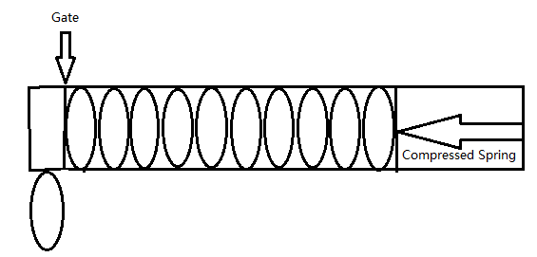
Dispensing Mechanism
Pills are pushed by a compressed spring to the gate.
Gate open, one pill is pushed into the empty room.
Gate close, pill drop.
ECE 4180 Final Project
Another similar pill-dispenser project by peer group

Slide 3
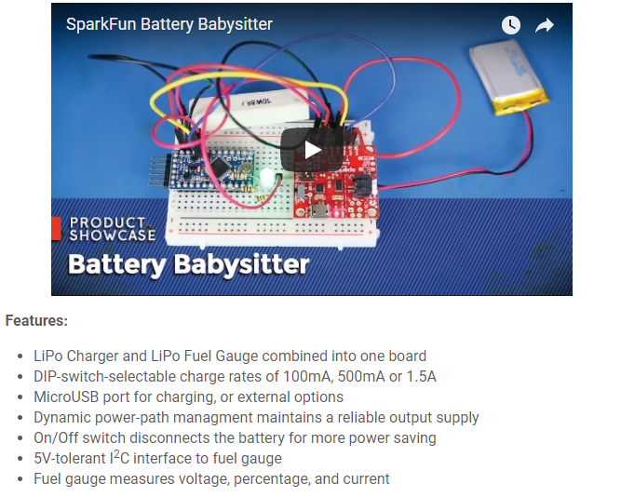
Power Management
The LiPo battery (Lithium Ion Polymer Battery)
Reason: the phone case needs to be rechargeable
Battery is to be stacked with other compartments
Details: 3.7V power supply (the following specs are from an Adafruit LiPo battery)
(2500mAh; temporary, but may be increased if needed)
Weight: 52g
Size: 2" x 2.55" x 0.30" (51mm x 65mm x 8mm)
Plan to use SparkFun Battery Babysitter - LiPo Battery Manager
Protects battery from overcharging and provides stable output

Slide 4
PCB Design
A PCB board containing:
NRF52 DK
Power circuitry
Bluetooth module
Output ports for dispensing motor or solenoid
Photoresistor sensor
Size: 140 mm height, 70mm wide, 35mm deep.
Design software: eagle or kicad

Slide 5
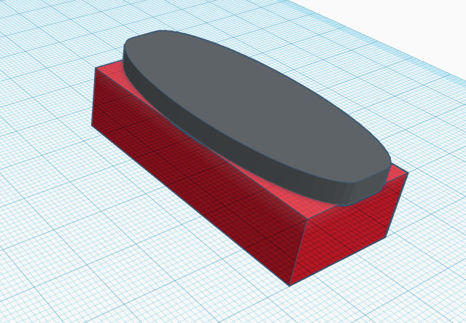
Phone Case Design
A 3D-printed case containing:
PCB board
battery
pill tray
dispensing mechanism
Able to mount on the smartphone
CAD design tool: tinkercad

Slide 6
App Development
System: Android 8.0
Development Platform: Android Studio 3.0 SDK
Main Functions:
Remind users to take pill according to loaded prescription.
Dispense medicine at users requests with Bluetooth.
Record users’ pill taking behavior.
Reload prescription or pills.
Monitor pill status and pill taking history.
Allow users to take pills even not in expected times.
Use phone sensors such as TouchID and GPS.

Slide 7
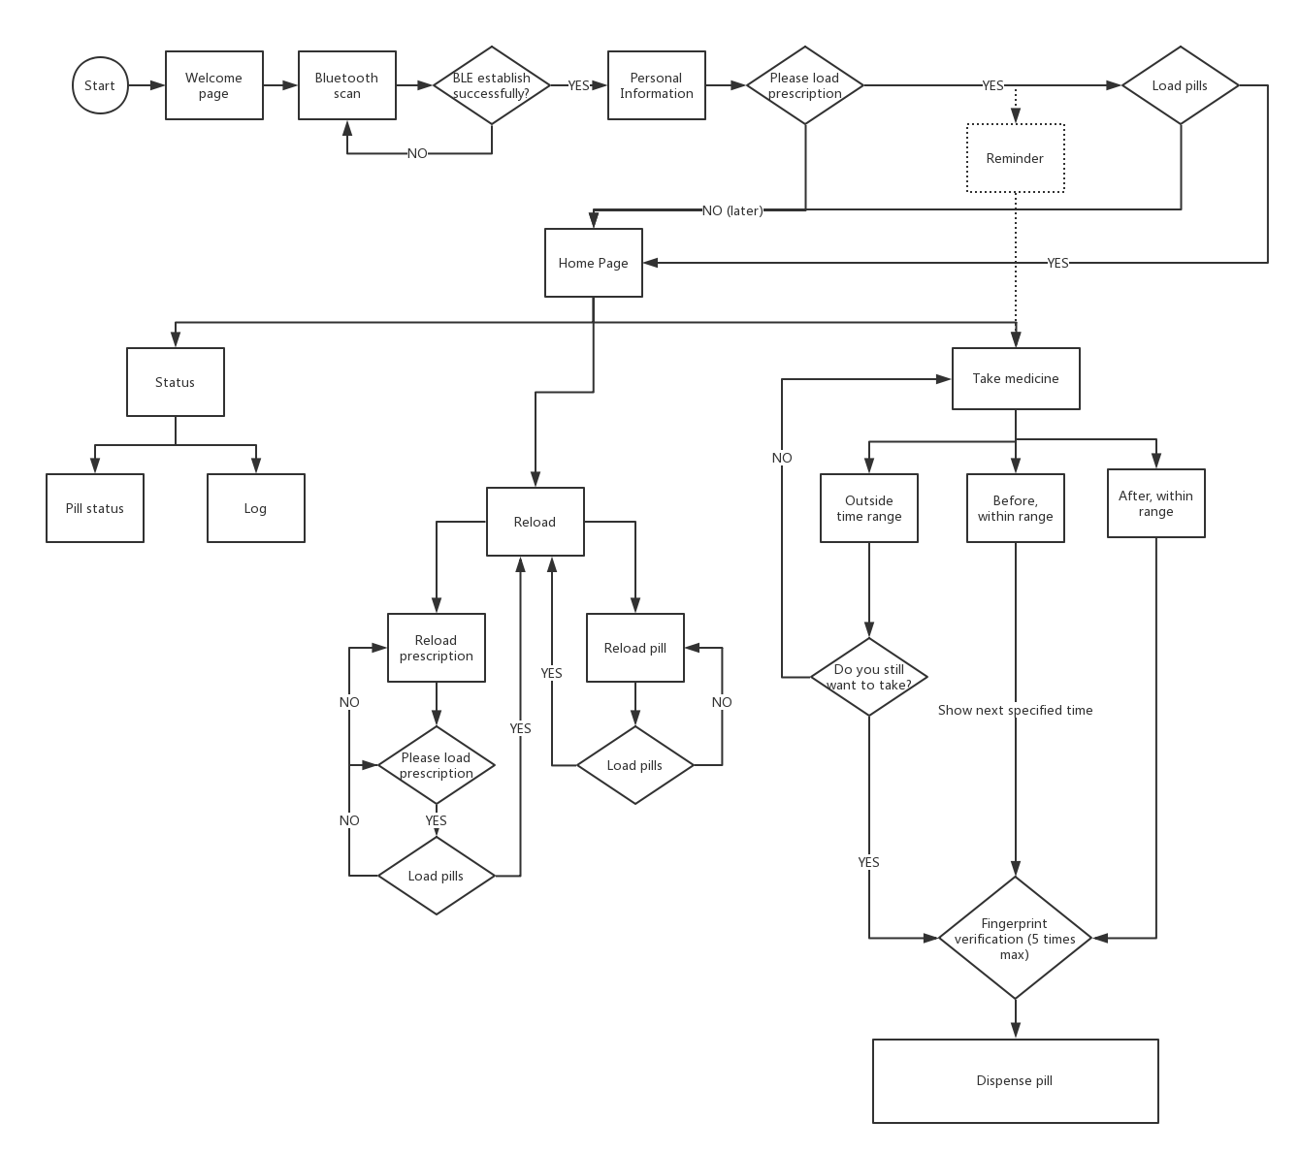
App Functionality
Flow Chart

Slide 8
Thank you

